Slide 1


Instant Messaging
daBlaqChat
03 June 2016

Slide 2
Contents
Instant Messaging Overview
Chat Applications
daBlaqObjectives
daBlaqChat
daBlaqArchitecture
daBlaqFlow Chart
daBlaqMessage Sequence Diagram
daBlaqClass Diagram
daBlaqDemo
daBlaqFuture Work
daBlaqCritical Analysis
daBlaqConclusion

Slide 3
Instant Messaging Overview
Instant Messaging is a type of online chat which offers real-time text transmission over the internet.
The earliest chat applications where the Internet Relay Chat, which was an application layer protocol that facilitates communication in a form of text, and another well known chat application was ICQ.
Linux chat applications without a Graphical User Interface are, Konversation, Xchat, Chatzilla and irssi.
The following application is a Linux CLI and is capable of communicating across multiple access networks - daBlaqChat

Slide 4






Chat Applications

Slide 5
daBlaqObjectives
To build a network focused and aware Instant Messaging Application, that will run on Linux CLI and be capable of communicating across multiple access networks.
The Instant Message app would have the following mandatory features:
Messaging between two clients
Auto-discovery on a closed network
Protocol selection based on access network (fixed - UDP or wireless - TCP)
Signaling reduction techniques
No failed deliveries
Offline and Online notifications on chat initiation
Must either use a client-server or peer to peer architecture (you need to justify your choice)

Slide 6
daBlaqChat
daBlaqChat is an open source chat application coded using Python language in socket programming. It is a Client-Server based model whereby clients communicate through the server. Two separate applications were programmed, (1) Server application and (2) Client application.
daBlaqChat can:
Message between two clients and more through the server
Create a socket and listen on it forever on a closed network
Accept new connections requesting to connect on the server’s socket
Use TCP stream socket to transmit data
Broadcast messages to other clients except the sender – prevent wasteful resources
No failed deliveries
Online notifications on chat initiation

Slide 7
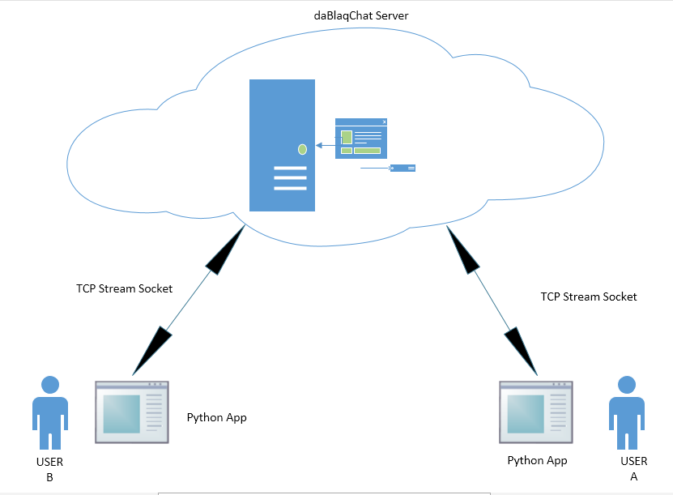
daBlaqArchitecture

Slide 8
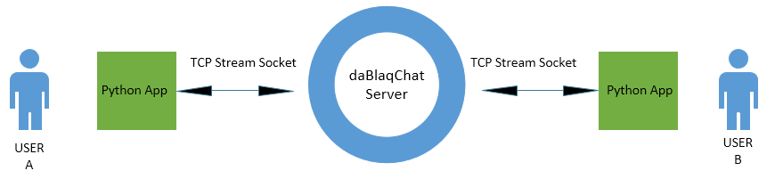
daBlaqArchitecture

Slide 9
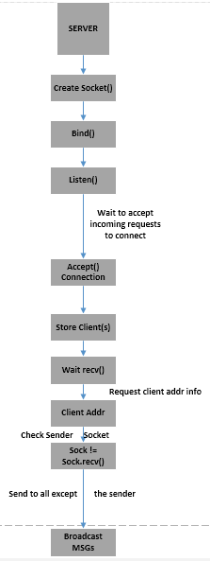
Flow Chart
Server Flow Chart

Slide 10
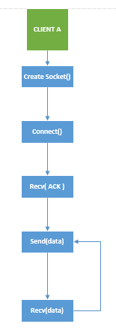
Flow Chart
Client Flow Chart

Slide 11
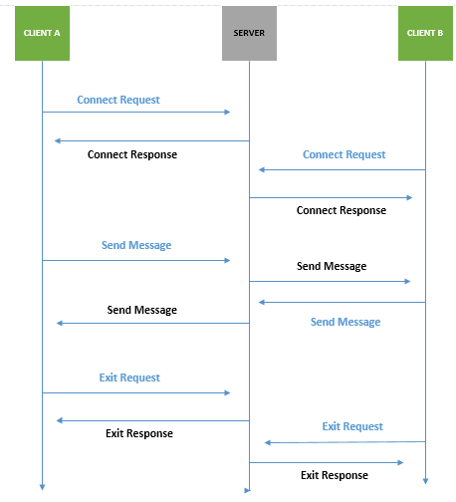
Message Sequence Diagram

Slide 12
Classes and Functions

Slide 13


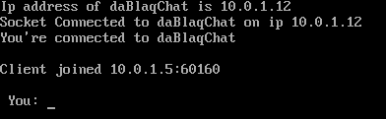

daBlaqDemo
Step 1: Server running and waiting for clients to connect.
Step 2: Client runs application and connects to Server. Server accepts connection.
Server
Client
Step 3: Additional clients connect to the Server. Connected clients are notified of new clients.
Server
Client

Slide 14




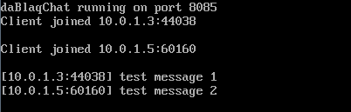
daBlaqDemo
Step 4: Client (C1) sends message to other connected clients (C2): “test message 1.”
Receiving Client (C2)
Sending Client (C1)
Step 5: : Client (C2) replies to other connected clients (C1): “test message 2.” Client is notified of successful message delivery. Server relays and displays all messages.
Sending Client (C2)
Receiving Client (C1)
Server

Slide 15

daBlaqDemo
Step 6: Client enter keyword “exit” to leave the chat.
Client

Slide 16
daBlaq-Future Work
Things that I would be able to do if I had more time:
Implement a login structure
Function to request Users online
Integrate optimization features, upgradability
Implement online/offline notification icon
Keep Users directory
Ability to make private chats and send messages even when offline

Slide 17
daBlaqCritical Analysis
Strengths:
Simple code structure
Easy to implement
Uses select function to handle multiple clients
Uses TCP, end-point of a connection is guaranteed
Messages are sent successfully, no failed deliveries
Message resources are not wasted
Weaknesses:
Only one class was used
Client application is a script, but allows restructuring
The code has poor extensibility
Has a few bugs, but can be fixed
Trade-Offs:
Used simple code instead of classes and functions (Client)

Slide 18

daBlaqConclusion
A simple basic chat server that allows users to communicate and exchange information over the internet.
Programmed using Python language, Server application under 40 lines of code and Client application under 53 lines of code, both interacting as one application unit to form a Chat Application running on a Linux CLI.

